Slide 1
Neural Style Transfer

Slide 2
AlexNet

Slide 3
CNN Visualization
Generative Methods
Class Activation Map(CAM)
Gradient Ascent
Feature Inversion
Deep Dream

Slide 10
VGG Net

Slide 18
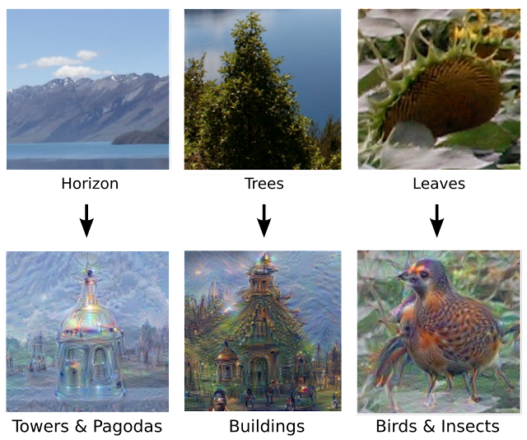

Slide 21
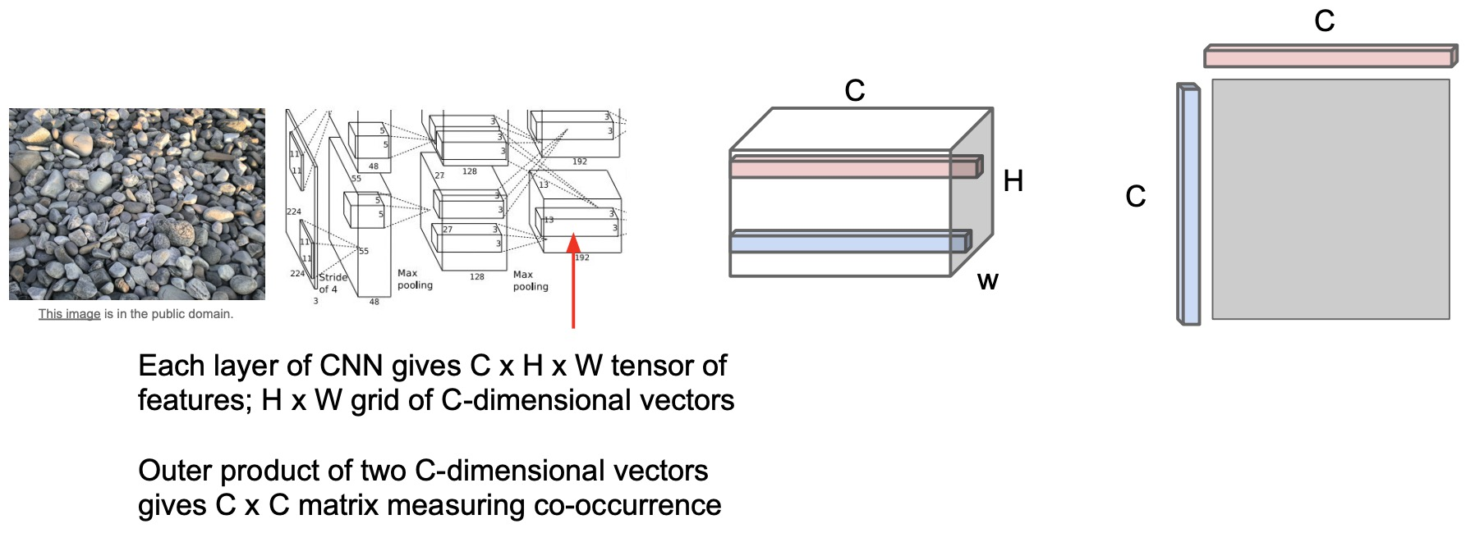
Neural Texture Synthesis: Gram Matrix (Quantifying Style)

Slide 22
VGG Net

Slide 37
References
https://smartgeometry-ucl.github.io/comp0169-20.github.io/

